Slide 1

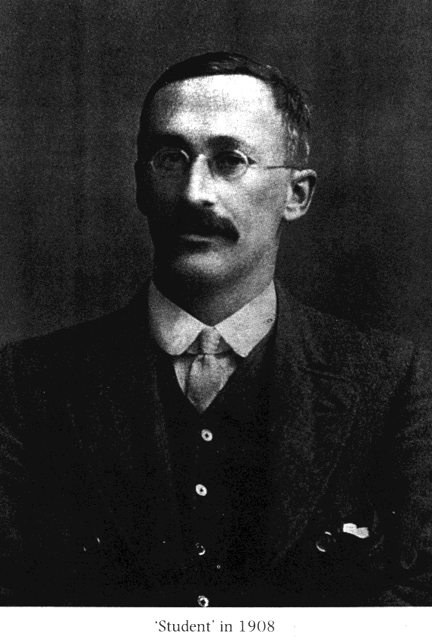

How shall I deal with these small batches of brew?
GOSSET, William Sealy 1876-1937

Slide 2
A series of distributions of sample means drawn from a population of standardized scores (therefore the mean of mean is 0 and sd=1), in which the shape of the distribution varies systematically, depending on the size of the sample. The larger the sample, the more it matches a normal distribution; and the smaller the sample, the fatter the tails.
GOSSET, William Sealy 1876-1937

Slide 3

A T distribution is derived by approximating the mean of a normally distributed population, particularly useful with an unknown standard deviation and a small sample size. To visualize how it functions, imagine an inverted letter T placed under this standard probability distribution, where the Two Tails of this inverted T are nestled within the Two Tails of the standard probability distribution, thus making the Two Tails Thicker than a Typical distribution. As the sample size rises, the range of potential outlier sample means derived from the population shortens; therefore, the Two Tails of the probability distribution shorten (along with the standard deviation) and Thus Thrust into the Two Tails of the inverted T, also causing the inverted T to rise and create a greater kurTosis
Jeremy Jimenez

Slide 4

XY
XY
XY
XY
XY
XY
XY
XY
XY
XY
XY
XY
XY
XY
XY
XY
XY
XY
XY
XY
XY
XY
XY
XY
XY
XY
XY
XY
XY
XY
XY
XY
XY
XY
XY
XY
XY
XY
XY
XY
XY
XY
ρ

Slide 5
Sample_{C}
Sample_{D}
r_{XY}
r_{XY}
Population
Sample_{B}
ρ_{XY}
r_{XY}
Sample_{E}
Sample_{A}
_
r_{XY}
r_{XY}

Slide 6
The t distribution, at N-2 degrees of freedom, can be used to test the probability that the statistic r was drawn from a population with ρ = 0. Table C.
H₀ : ρ _{XY} = 0
H₁ : ρ _{XY} ≠ 0
where
r N - 2
t =
1 - r²

Slide 7
Monday, November 7
Independent samples t-test
for the difference between two means.

Slide 8
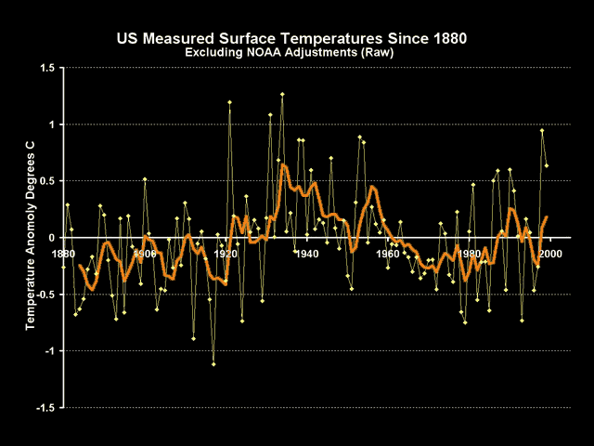
Monday, November 7
Independent samples t-test
for the difference between two means.
signal-to-noise ratio

Slide 9

Monday, November 7
Independent samples t-test
for the difference between two means.
signal-to-noise ratio
safety in numbers

Slide 10
_
_
X₁- X₂
_
_
_
_
X₁- X₂
_
_
_
_
X₁- X₂
_
_
X₁- X₂
X₁- X₂
X₁- X₂
_
_
_
_
X₁- X₂
_
_
_
_
_
_
X₁- X₂
X₁- X₂
_
_
X₁- X₂
X₁- X₂
X₁- X₂
X₁-X₂
μ1- μ2

Slide 11
H₀ : μ₁ - μ₂ = 0
H₁ : μ₁ - μ₂ ≠ 0

Slide 13
_
_
X_{boys}=53.75
X_{girls}=51.16
How do we know if the difference between these means,
of 53.75 - 51.16 = 2.59, is reliably different from zero?

Slide 14
We could find confidence intervals around each mean...
_
X_{boys}=53.75
95CI: 52.07 < μ _{boys} < 55.43
_
X_{girls}=51.16
95CI: 49.64 < μ _{girls} < 52.68

Slide 15
H₀ : μ₁ - μ₂ = 0
H₁ : μ₁ - μ₂ ≠ 0
But we can directly test this hypothesis...

Slide 16
H₀ : μ₁ - μ₂ = 0
H₁ : μ₁ - μ₂ ≠ 0
To test this hypothesis, you need to know …
…the sampling distribution of the difference between means.
-
-
σ_{X1-X2}

Slide 17
H₀ : μ₁ - μ₂ = 0
H₁ : μ₁ - μ₂ ≠ 0
To test this hypothesis, you need to know …
…the sampling distribution of the difference between means.
-
-
σ_{X1-X2}
…which can be used as the error term
in the test statistic.

Slide 18
The sampling distribution of the difference between means.
σ_{X1-X2} = √ σ²_{X1} + σ²_{X2}
-
-
-
-
This reflects the fact that two independent variances
contribute to the variance in the difference between
the means.

Slide 19
The sampling distribution of the difference between means.
σ_{X1-X2} = √ σ²_{X1} + σ²_{X2}
-
-
-
-
This reflects the fact that two independent variances
contribute to the variance in the difference between
the means.
Your intuition should tell you that the variance in the
differences between two means is larger than the variance
in either of the means separately.

Slide 20
The sampling distribution of the difference between means,
at n = ∞, would be:
-
-
(X₁ - X₂)
z =
σ_{X1-X2}
-
-

Slide 21
The sampling distribution of the difference between means.
-
-
σ_{X1-X2} = σ²₁ σ²₂
+
n₁ n₂
Since we don’t know σ, we must estimate it with the sample statistic s.

Slide 22
The sampling distribution of the difference between means.
-
-
σ_{X1-X2} = s²₁ s²₂
+
n₁ n₂
Rather than using s²₁ to estimate σ²₁ and s²₂ to estimate σ²₂ , we pool the two
sample estimates to create a more stable estimate of σ²₁ and σ²₂ by assuming
that the variances in the two samples are equal, that is, σ²₁ = σ²₂ .

Slide 23
s_{p}² s_{p}²
s_{X1-X2} =
+
N ₁ N₂

Slide 24
s_{p}² s_{p}²
s_{X1-X2} =
+
N₁ N₂

Slide 25
s_{p}² s_{p}²
s_{X1-X2} =
+
N₁ N₂
SS_{w} SS₁ + SS₂
s_{p}² =
=
N-2 N-2

Slide 26
Because we are making estimates that vary by degrees of freedom,
we use the t-distribution to test the hypothesis.
(X₁ - X₂) - (μ₁ - μ₂ )
t =
s_{X1-X2}
…at (n₁ - 1) + (n₂ - 1) degrees of freedom
(or N-2)

Slide 27
Assumptions
X₁ and X₂ are normally distributed.
Homogeneity of variance.
Samples are randomly drawn from their respective populations.
Samples are independent.

